Slide 1

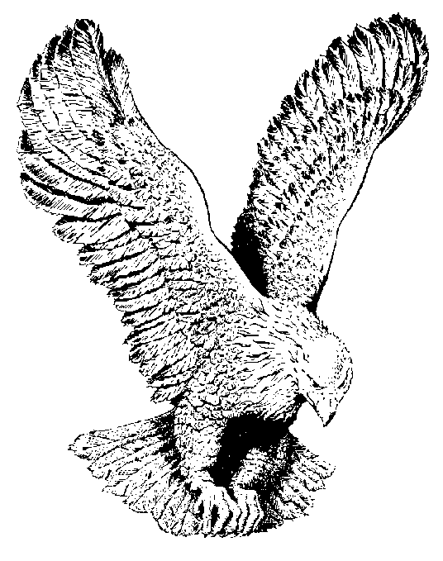
MICAH 6:8
He hath shewed thee, O Man,
What is good;
And what doth the lord require of thee,
But to do justly, and to love mercy,
And to walk humbly with thy God.

